Slide 1
Bloom
A Tech Based Solution for Women Health.

Slide 2
INDEX
CONTENT | PAGE NO.
Case Study | 3
Motivation | 5
Problem | 6
Objective | 8
Solution | 9
Technology Stack | 10
App Structure | 12
Working | 14
Future Scope | 15
Conclusion | 16

Slide 3
Case Study
A few days back , my housekeeper named Shanti , 52 year old ,asked help from me. She had pain in her chest from 2 weeks. She went to her locality hospital but nothing was diagnosed. And then she told me about this. I took her to hospital and after certain visits it was diagnosed that she is suffering from Breast Cancer. It was so hard for her and for me after hearing this.
From this, I got inspiration to help other women like Shanti to get early predictions of such fatal disease like Breast Cancer and spread awareness about this so that many lives could save.

Slide 4
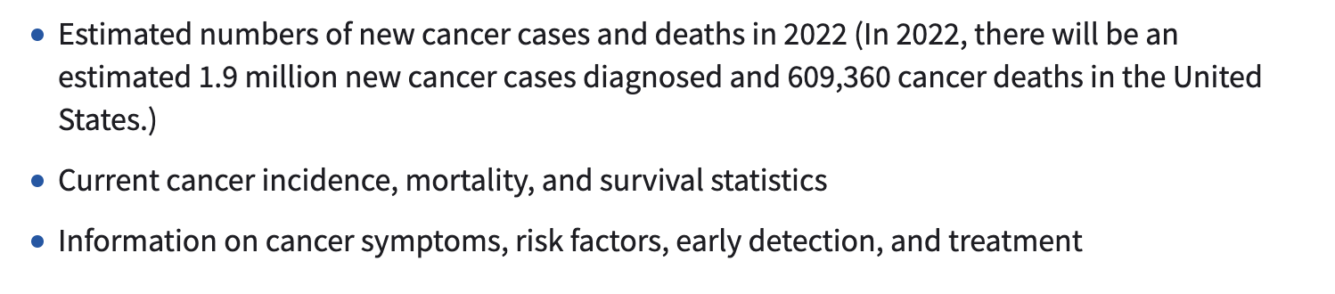
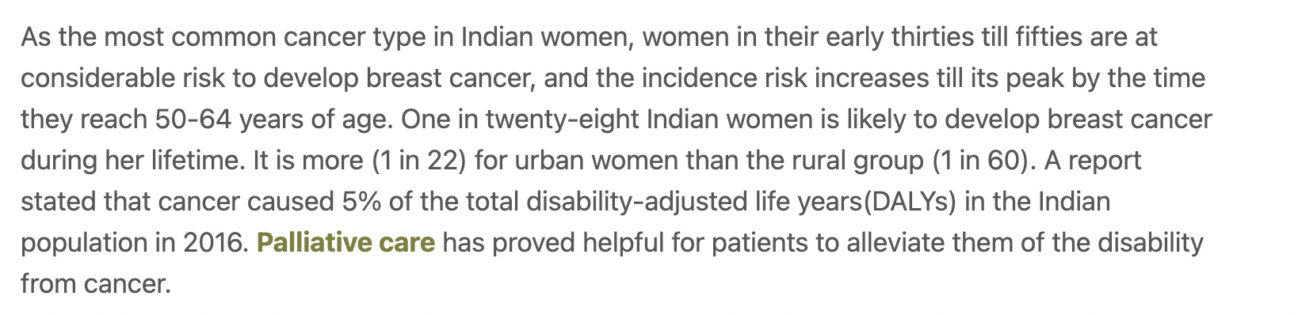
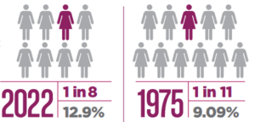
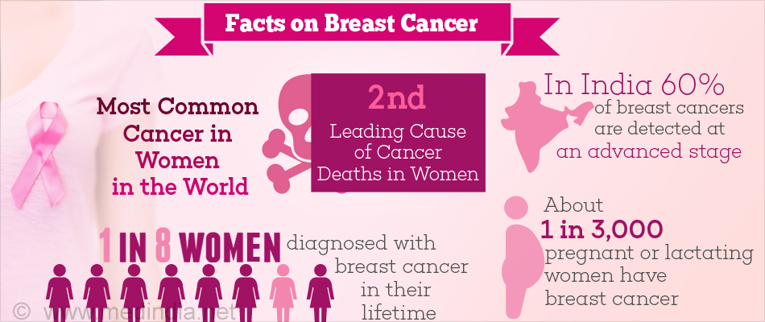
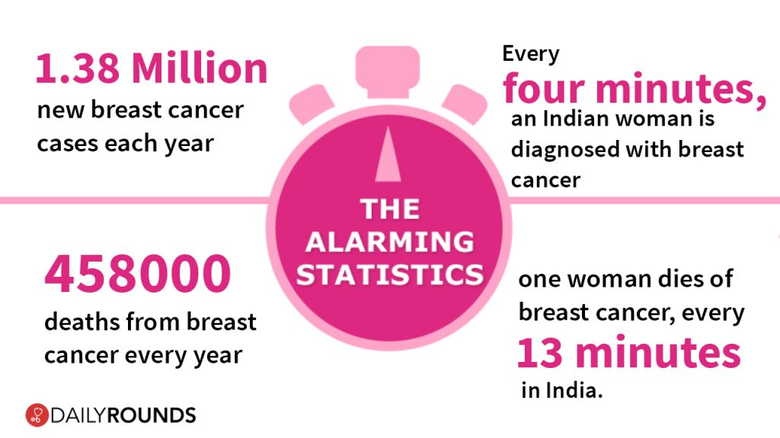
Statistics

Slide 5
Women empowering is an important issue. Several methods have been introduced to empower women. Health information seeking is one of the most important activities in this regard.
It is important for women to take care of their health and take necessary precautions at right time.
Women get marginalised when it comes to accessing the highest level of public healthcare in India, according to a study conducted at a large, tertiary hospital, the All India Institute of Medical Sciences (AIIMS) in New Delhi.
Although India has seen steady improvement in tertiary healthcare in the past few years, women are still the last to receive treatment.
Motivation

Slide 6
Problem
There is not any application available that helps in awaring women regarding the women specific diseases and on the same time help them to take care of themselves. For vulnerable women, we will provide a monetary support collected as fund so that they can have their treatment done without any obstacle. For example, Breast cancer is a type of cancer that starts when cells begin to grow out of control and can led to death. As breast cancer is major issue which cannot be neglected so precautions and treatment is mandatory for it. There are many such diseases that are ignored for which we are developing a solution.

Slide 7
“I’m interested in women’s health because I’m a woman. I’d be a darn fool not to be on my own side.” – Maya Angelou

Slide 8

Objective
The objective of our app is to empower women in health sector so that they have awareness of fatal diseases like Breast Cancer, Cervical Cancer, Osteoporosis, Cardiovascular Disease etc. They can also schedule their appointment to meet doctors via our app. Our solution will also provide support to the women who cannot afford the treatment expenses.

Slide 9
Solution
Developing a web application that will be a health portal for women for getting awareness and treatment of the diseases which are mostly found in women.
The app will consist of 2 portals.
One for the doctors, in which all the appointments will be shown and they can handle all the data for themselves.
The second one is for the women for getting information regarding the diseases, to make appointments with female doctors, self analysation through series of predefined questions created with professionals and to raise funds for the treatment of unprivileged women.
Initially we are taking Breast Cancer as the first module.
The complete flow of the application will be defined in the coming slides.

Slide 10
Technology Stack
Azure- App Service, Azure Cosmos DB, Azure Health Bot.
FireBase Service
Frontend- ReactJS
Database- MongoDB
Backend- Node, Express
Third Party APIs

Slide 11
App structure

Slide 12
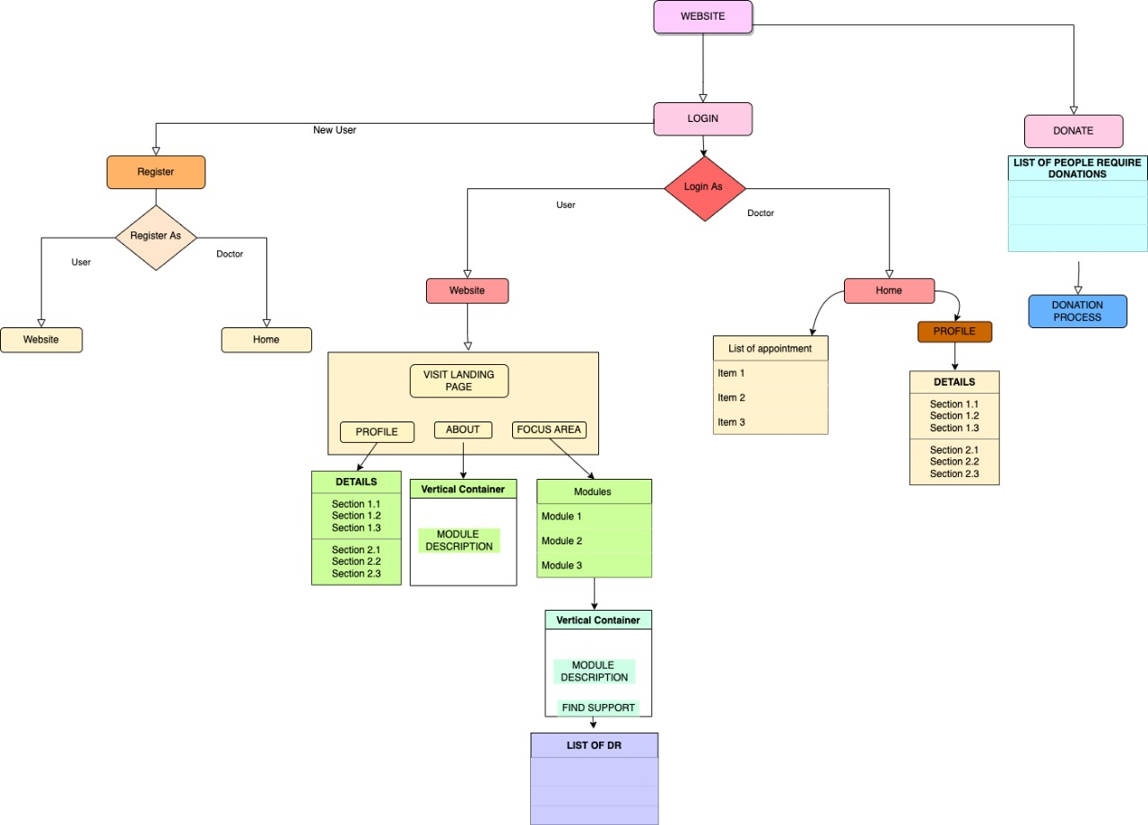

Slide 13
Working

Slide 14
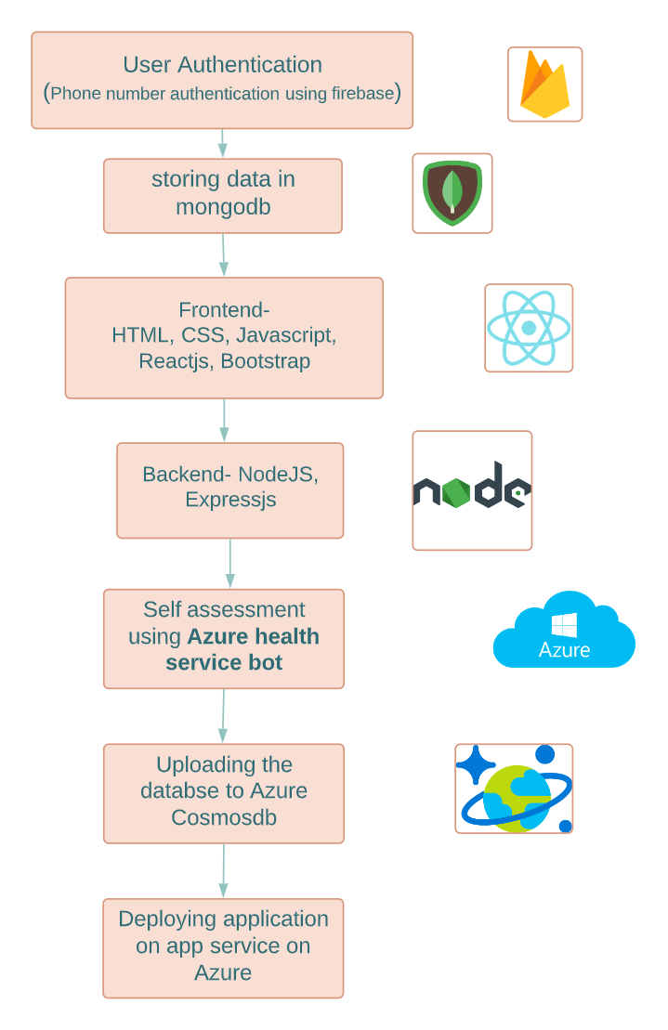

Slide 15
Future Scope
In future ,many update will be added.
A real time map.
Real time video call.
It will help many women irrespective of their economic status as fund raising feature will be there.
It will also help doctors to get recognized.
Moreover a user interface is so easy that it can be easily handled by anyone.
Appointments can be scheduled or rescheduled easily according to patient convenience.
Voice assistant.
Video presentation and animated videos for those who don’t understand any language.

Slide 16
Conclusion
Empowering women is an important subject of today's world. The term “empowered” refers to the possession of legal power or autonomy to act.
Increased empowerment of women is likely to increase their ability to seek out and use health services to better meet their own reproductive health goals.
Hence we are developing a web application Bloom that will be a health portal for women for getting awareness and treatment of the diseases which are mostly found in women, right now focusing on breast cancer.
They can also schedule their appointment to meet doctors via our app. And our solution will also provide support to the women who cannot afford the treatment expenses.

Slide 17
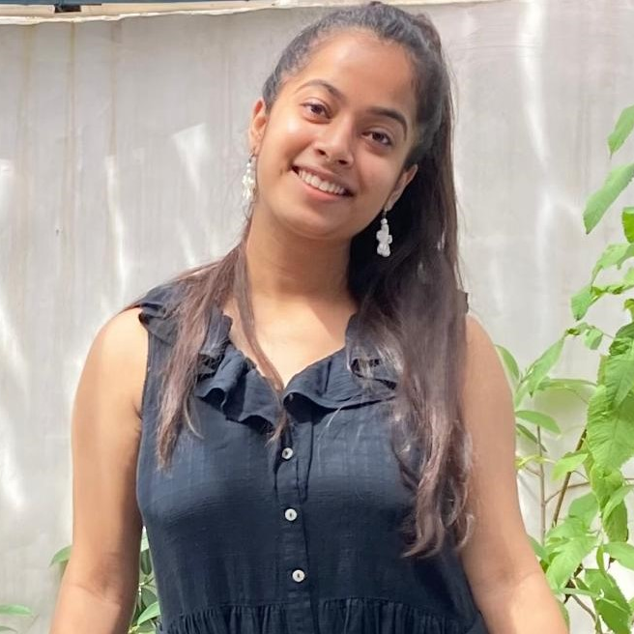

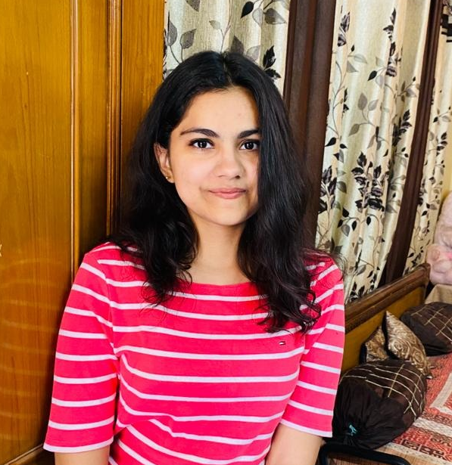

Team Details
Riya Verma TEAM LEADER
Shruti Sharma MEMBER
Divyanshi Oberoi MEMBER
Palvi Sabharwal MEMBER

Slide 18

Thank You!

